Slide 1
E-Book Management System

Slide 2
Introduction
The E-Book Management System is a software application designed to streamline the management and organization of electronic books (e-books). With the increasing popularity of digital books, it has become essential for individuals and organizations to efficiently handle their e-book collections.
This system aims to provide a user-friendly platform for users to search, categorize, and manage their e-books effectively. The system offers a range of features to enhance the user experience and facilitate easy access to e-books. It includes functionalities such as book searching, adding books to personal libraries, tracking reading progress, generating recommendations, and more.

Slide 3
Key Features
E-Book Catalog: The system maintains a comprehensive catalog of e-books, including details such as title, author, genre, and description. Users can search for specific books or browse through different categories to find their desired e-books.
Personal Libraries: Users can create their personal libraries within the system, allowing them to organize and manage their e-books efficiently
Recommendations and Suggestions: The E-Book Management System employs intelligent algorithms to provide personalized recommendations based on users' reading history, preferences, and popular books in similar genres.
User Interaction: The system facilitates user interactions through features like book ratings, reviews, and comments. Users can rate and provide feedback on e-books they have read, allowing others to make informed decisions when selecting books.
E-Book Formats and Compatibility: The system supports various e-book formats, ensuring compatibility with a wide range of devices and e-reader applications. Users can upload their e-book files or connect to external platforms for purchasing or downloading e-books.

Slide 4
Hardware Requirements
Processor: A modern processor with adequate processing power to handle the system's functionalities and user interactions smoothly.
Memory (RAM): Sufficient RAM to ensure optimal performance, depending on the scale of the project and expected user load.
Storage: Sizable storage space to accommodate the e-book catalog, user libraries, and related data.
Network: A stable network connection to facilitate data retrieval, updates, and potential integration with external e-book platforms

Slide 5
Software Requirements
Operating System: Choose an operating system that best suits your development environment and target deployment platform, such as Windows, macOS, or Linux.
Database Management System: Database management system (DBMS) to store and manage e-book data efficiently. Popular options include MySQL, PostgreSQL, or MongoDB.
Web Server: If the system will be web-based, consider using a web server like Apache or Nginx to host and serve the application.
Programming Languages and Frameworks:
IDE: Eclipse
Language: Java, JSP, HTML, CSS and JavaScript.

Slide 6
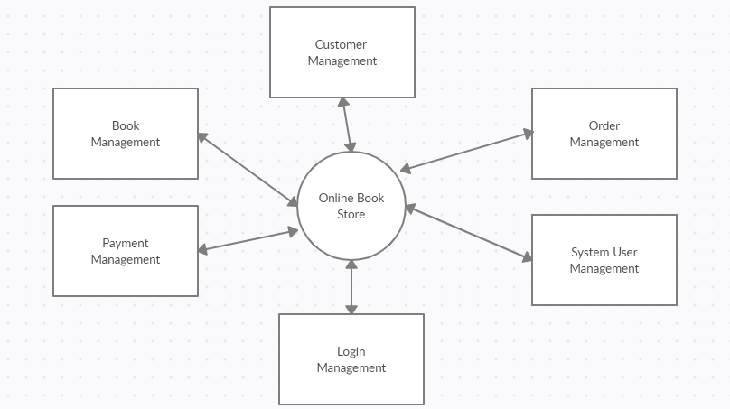
Data Flow Diagram

Slide 7
Software Development Life Cycle Model (SDLC)
The Software Development Life Cycle (SDLC) model commonly used in an E-Book Management System project is the Agile model, specifically the Scrum framework.
The Agile model is well-suited for projects that require flexibility, adaptability, and frequent collaboration with stakeholders. It focuses on iterative and incremental development, allowing for the delivery of working software called sprints.
The SDLC in an E-Book Management System project using the Agile model typically follows these phases:
Requirements Gathering: Collaboratively defining the system requirements and creating a product backlog.
Sprint Planning: Selecting a set of requirements from the product backlog for the upcoming sprint and creating a sprint backlog.
Sprint Execution: Developing and testing the selected requirements within the sprint timeframe.
Sprint Review: Demonstrating the completed work to stakeholders and gathering feedback.

Slide 8
Benefits
Efficient e-book organization: The system helps users keep their e-book collections well-organized, making it easier to locate and manage their digital books.
Enhanced reading experience: Users can track their reading progress, receive personalized recommendations, and engage in discussions, improving their overall reading experience.
Time-saving search and discovery: The system's search capabilities and recommendation engine save users' time by suggesting relevant books and providing quick access to their desired titles.
Collaborative features: Users can share their libraries, recommendations, and reviews with others, fostering a sense of community and enabling the exchange of book recommendations.

Slide 9
Future Updates
Enhanced User Interface: Improve the user interface to provide a more intuitive and seamless experience for users.
Personalization Features: Implement features that allow users to personalize their reading experience. This can include options for customizing font styles, text size, themes, and bookmarking favorite e-books.
Recommendations and Discovery: Incorporate intelligent recommendation algorithms to suggest relevant e-books based on users' reading preferences, browsing history, and ratings. Enhance the discovery process by providing curated lists, featured collections, and genre-specific recommendations.
Social Features: Integrate social features that enable users to share their reading lists, reviews, and recommendations with friends or within the e-book community.

Slide 10
Conclusion
The E-Book Management System is a valuable tool that simplifies the management of e-book collections, offering users an intuitive and efficient platform for organizing, accessing, and discovering e-books. With its user-friendly interface and intelligent features, this system enhances the reading experience and caters to the needs of individuals and organizations that rely on digital books.
The system provides a user-friendly interface, personalized reading experiences, and features such as recommendations and social sharing. It allows users to easily browse, search, and download e-books, promoting a seamless reading experience. For publishers, the system facilitates content management, sales tracking, and analytics to optimize their offerings. The E-Book Management System streamlines the entire lifecycle of e-books, from acquisition to distribution, ensuring that users can enjoy a wide range of titles conveniently.

